Slide 1
Analog Electronics Lab Experiment-9
Instructors name:
P3:
Ashish Kumar Varma
Sambhavi Shukla
P4:
Ankita Dixit
Premsai Regalla

Slide 2
Integrated Circuit Timer

Slide 3
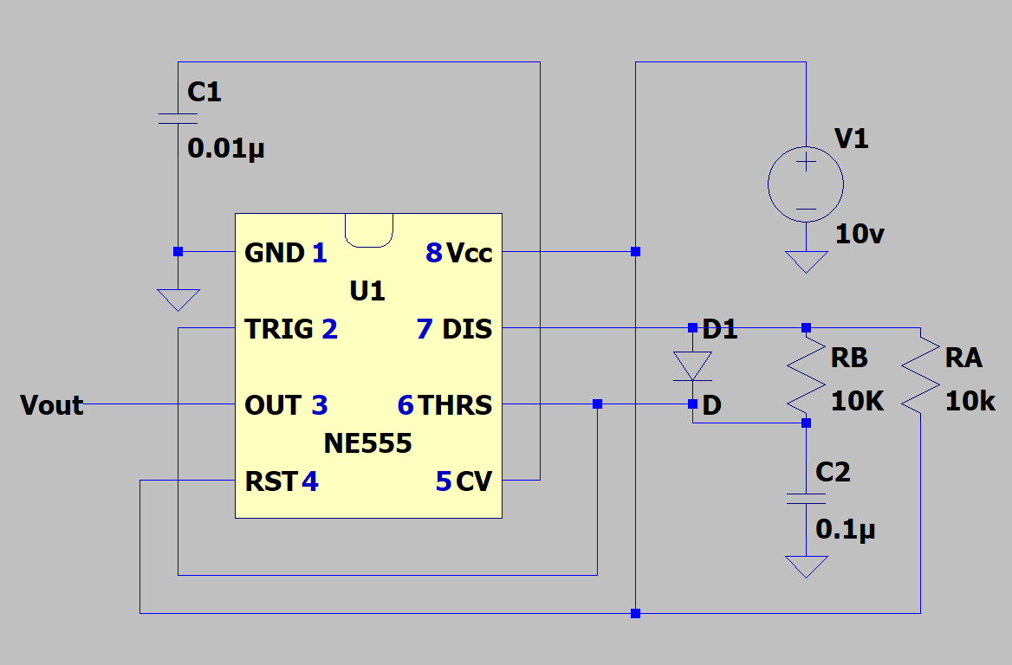
Astable Multivibrator Symmetrical Square Wave Generator

Slide 4
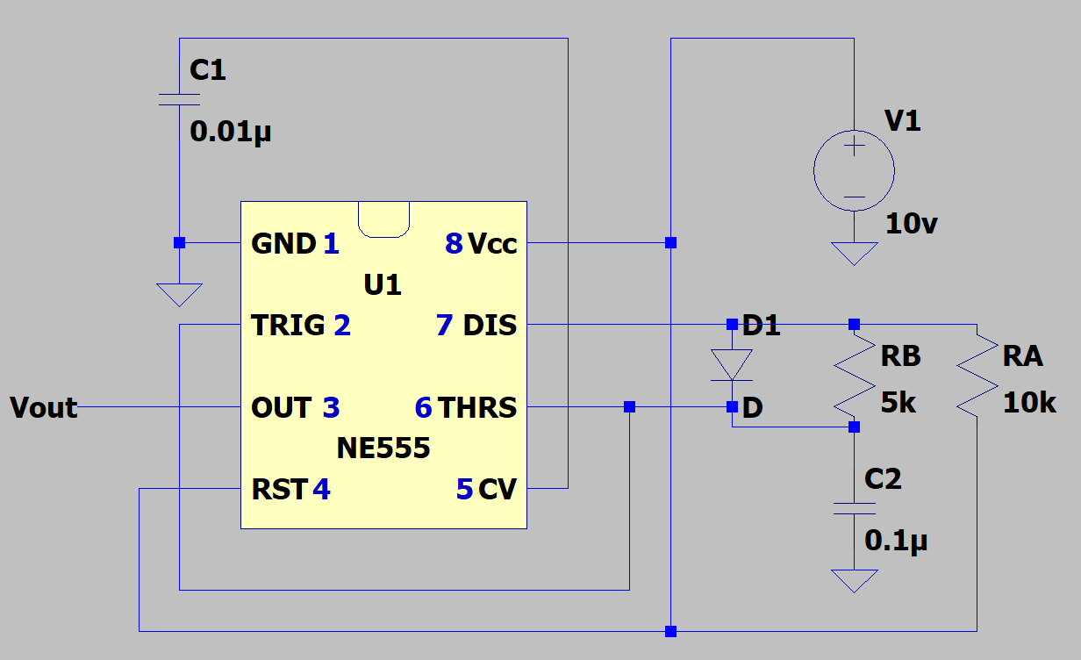
Astable Multivibrator Asymmetrical Square Wave Generator

Slide 5
Assignment:
To study Timer
1) Astable Multivibrator (Symmetrical Square Wave Generator)
2) Astable Multivibrator (Asymmetrical Square Wave Generator)
Upload a single PDF file on Nalanda which includes
1) Circuit diagrams for both configurations.
2) Waveforms for two configurations.
3) Measure duty cycle, frequency , amplitude and compare your theoretical and simulated values.
Submit the report in a single PDF format (file name should be your ID) on Nalanda within 48 hrs., after your lab section. (2 marks deduction for late submission) Personal submission on email will not be considered.

